Slide 1
Large Language Models

Slide 2
Instructor Info
Mohammad Javad Dousti
  Office: ECE Building 2; Room 719
  Office Hours: Saturdays and Mondays 17:30 – 18:00
  Email: mjdousti@ut.ac.ir (I’ll try my best to respond within one business day)
Yadollah Yaghoobzadeh
  Office: ECE Building 2; Room 516; TeIAS room
  Office Hours: Saturdays and Mondays 17:30 – 18:00
  Telegram: yyaghoobzadeh

Slide 3
My introduction (Yadollah Yaghoobzadeh)
1389, BSc in software engineering from University of Tehran
1392, MSc in software engineering from Sharif University of Technology
1396, PhD in NLP from LMU Munich
1396—1399, Researcher at Microsoft Research and Turing
1399—Now, Assistant professor at University of Tehran

Slide 4
My introduction (Mohammad Javad Dousti)
1389, BS in computer engineering from Sharif University of Technology
1394, MSc in electrical engineering from University of Southern California
1394, PhD in computer engineering from University of Southern California
1394—1399, Research Scientist at Meta Inc. (formerly Facebook, Inc.)
1399—Now, Assistant professor at University of Tehran

Slide 5
Class Info
When: Saturdays & Mondays 13:00 – 14:30
Where: Class #
Class web page:
  Teams for assignments
  Discussion group:
    Telegram group:

Slide 6
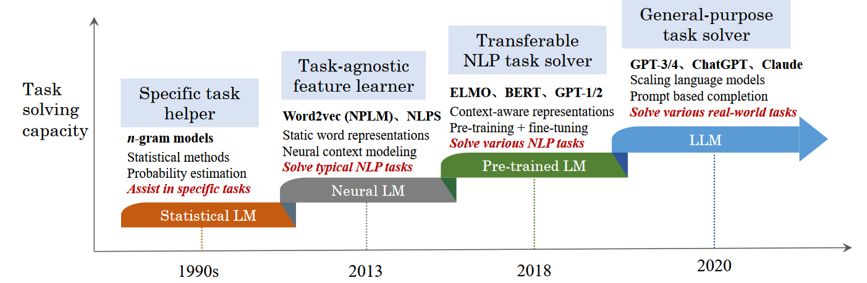

Slide 7
What are large language models (LLMs)?

Slide 8
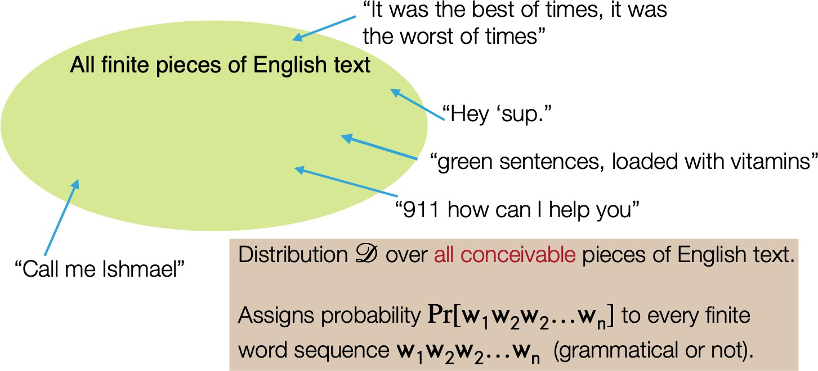
Language models: narrow sense
A probabilistic model that assigns a probability P[w₁, w₂, …, w_{n}] to every finite sequence w₁, …, w_{n} (grammatical or not)

Slide 9
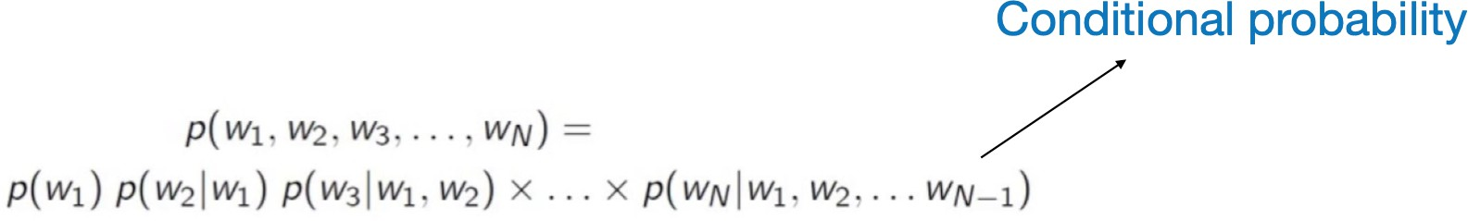
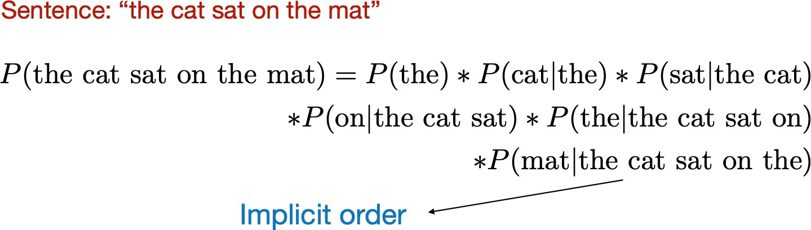
Language models: narrow sense
GPT-3 still acts in this way but the model is implemented as a very large neural network of 175-billion parameters!

Slide 10
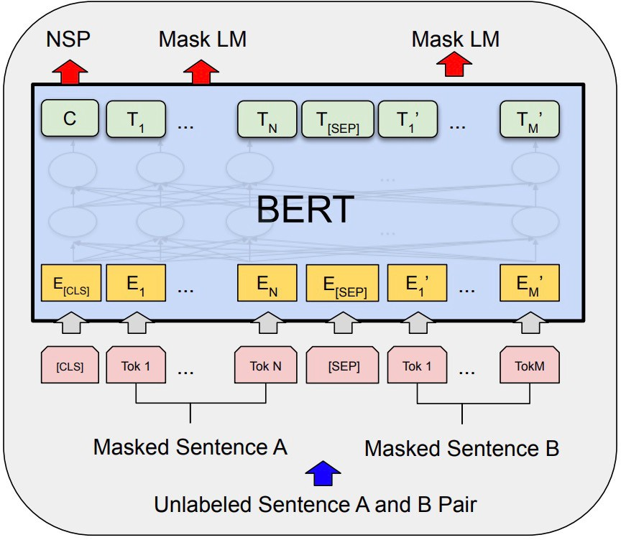
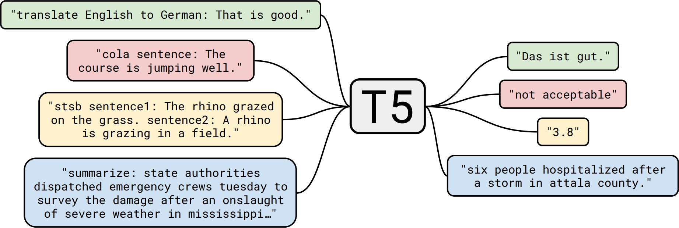
Language models: broad sense
Decoder-only models (GPT-x models)
Encoder-only models (BERT, RoBERTa, ELECTRA)
Encoder-decoder models (T5, BART)

Slide 11
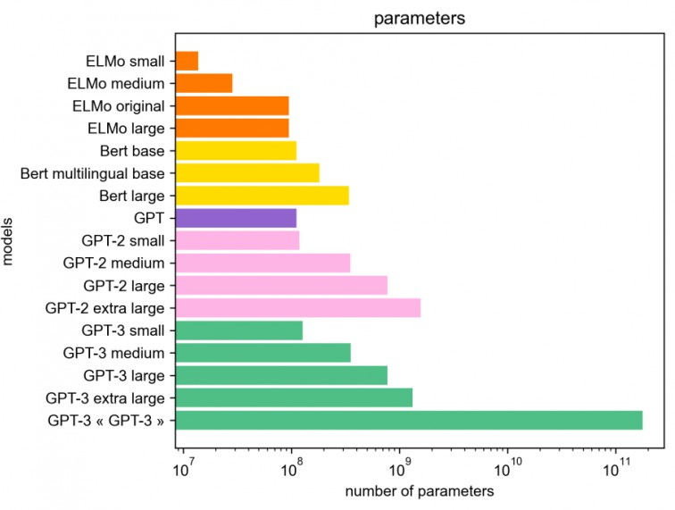
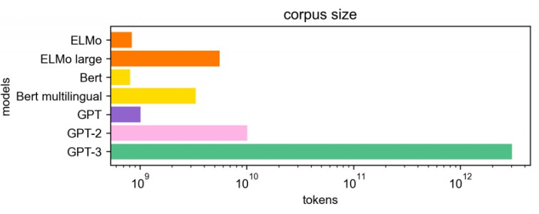
How large are “large” LMs?
More recent models: PaLM (540B), OPT (175B), BLOOM (176B)…
Image source: https://hellofuture.orange.com/en/the- gpt-3-language-model-revolution-or-evolution/

Slide 12
How large are “large” LMs?
Today, we mostly talk about two camps of models:
  Medium-sized models: BERT/RoBERTa models (100M or 300M), T5 models (220M, 770M, 3B), LLAMA/Phi/Misteral models (7B-100B)
  “Very” large LMs: models of 100+ billion parameters
Larger model sizes ⇒ larger compute, more expensive during inference
Different sizes of LMs have different ways to adapt and use them
  Fine-tuning, zero-shot/few-shot prompting, in-context learning, …
Emergent properties arise from model scale
Trade-off between model size and corpus size
Q: Do largest models always give the best performance today?

Slide 13
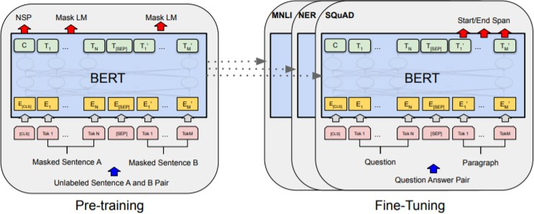
Pre-training and adaptation
Pre-training: trained on huge amounts of unlabeled text using “self-supervised” training objectives
Adaptation: how to use a pre-trained model for your downstream task?
  What types of NLP tasks (input and output formats)?
  How many annotated examples do you have?
20

Slide 14
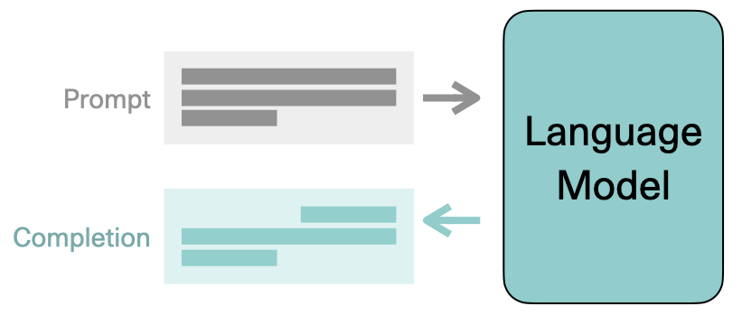
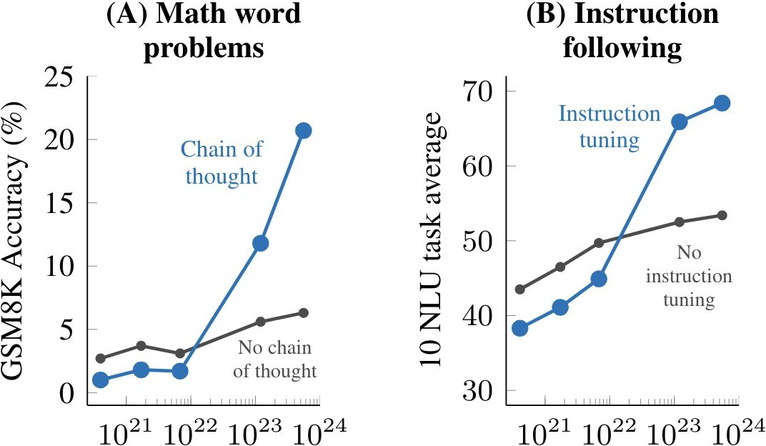
Why LLMs?
The promise: one single model to solve many NLP tasks
Emergent properties in LLMs
Image credit: Jay Alammar
(Wei et al., 2022)

Slide 15
What are we going to cover in the class?

Slide 16
Overview of the course
LLM Basics
  Reviewing basic NLP and neural network concepts
  BERT/RoBERTa (encoder-only models)
  T5/BART (encoder-decoder models)
  GPT3 (decoder-only models)
Use and adapt
  Prompt-based learning
  Parameter-efficient finetuning
  In-context learning
  Reasoning (chain-of-thought, etc.)
  Knowledge
  Retrieval-augmented LMs
  Multi-linguality
Anatomy of LLMs
  Data (scaling, types, preprocessing)
  Scaling
Training, alignment, and optimization
  Instruction tuning
  Training LMs with human/LMs feedback
  Quantization
  Evaluation
Risks
  Privacy
  Ethics: Bias & Toxicity
Applications
New trends: Multimodal LMs and Sparse models

Slide 17
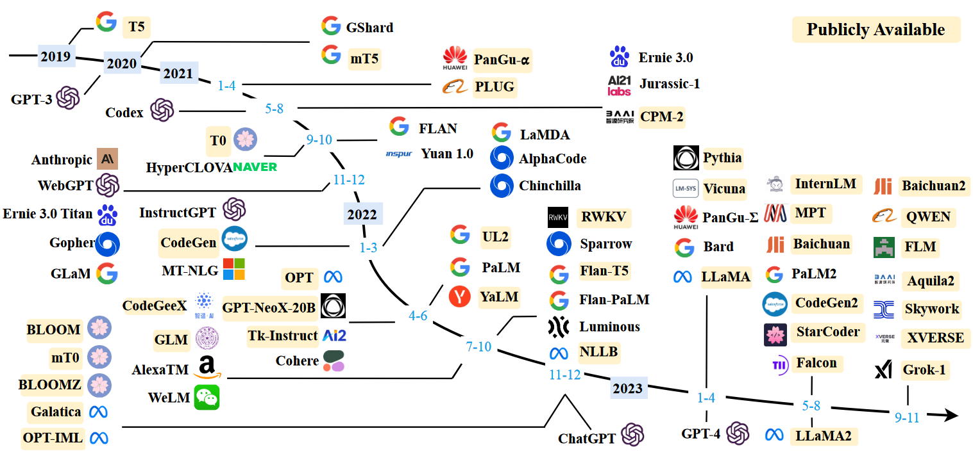
Recent Large Language Models (>10B Parameters)
Wayne Xin Zhao et al. "A survey of large language models." arXiv preprint arXiv:2303.18223 (2023).

Slide 18
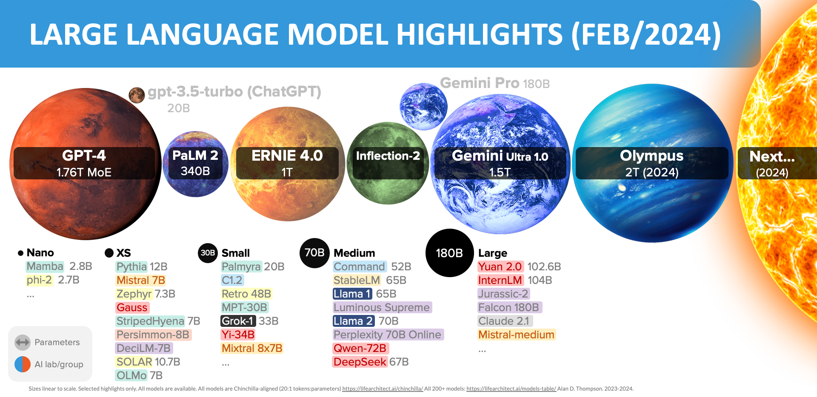
Language Model Sizes (Up to February 2024)
Source: https://lifearchitect.ai/models/

Slide 19
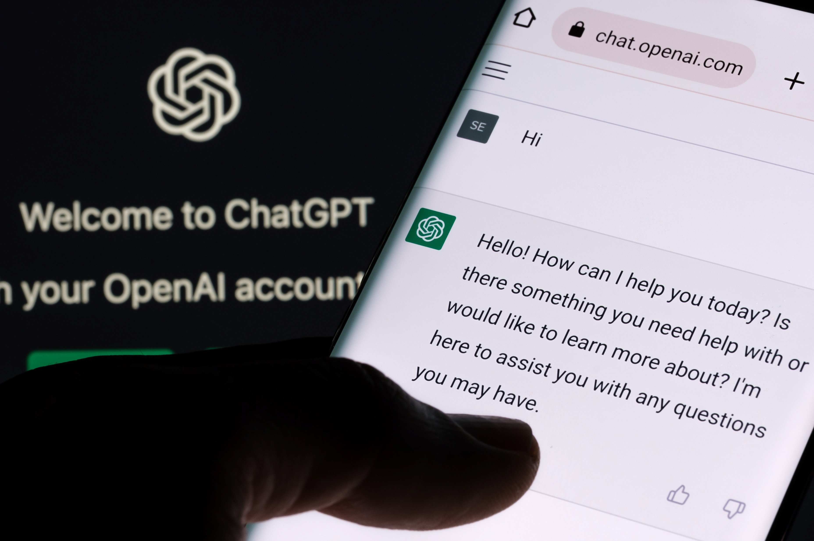
Demos
https://chat.openai.com/

Slide 20

Demos
https://gemini.google.com/

Slide 21
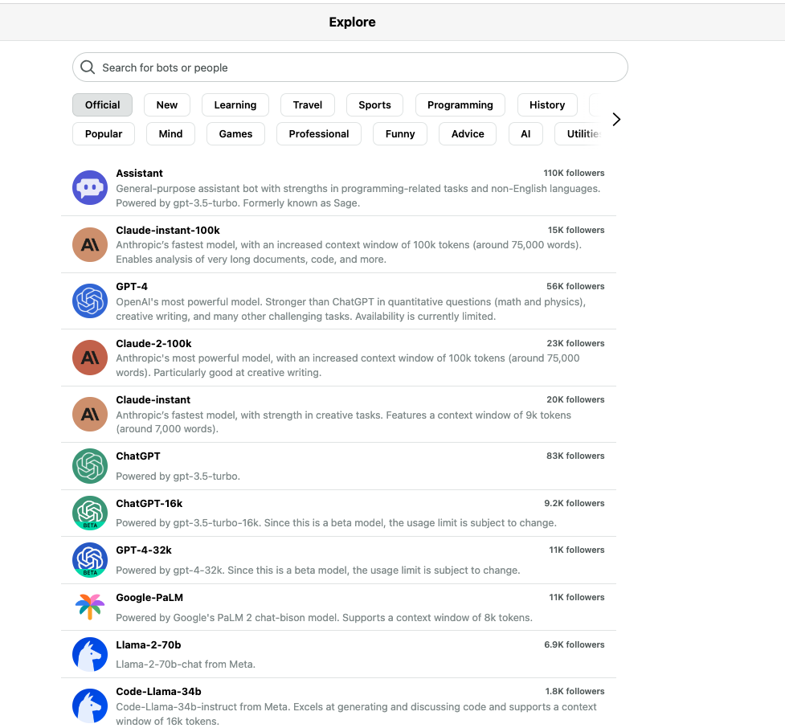
Demos
https://poe.com/

Slide 22
Teaching Assistants
Chief: Pedram Rostami
Sepehr Kamahi
Danial Namazifard
Mohammad Mahdi Mohajeri
Ali Salemi
Mohammad Azimi

Slide 23
Prerequisites
Comfort with Python programming and algorithmic thinking
Comfort with machine learning, especially supervised and deep learning
Familiarity with basic NLP concepts and tasks, including understanding (text classification, textual entailment, question answering) and generation (translation, summarization) tasks
Familiarity with probability and mathematical notations
Passion to learn
LLM — Spring 1403

Slide 24
Grading (subject to change)
Midterm: 20%
Final: 30%
Computer assignments (CAs): 30%
Final project: 20%
Pop quizzes and class participation: Up to 10%

Slide 25
Final project
Choose a topic
Project proposal
Building teams
Progress report (initial phases of a paper)
Final report / paper / presentation

Slide 26
Project types
Application
  A new model or scenario of using FMs in a task.
  The task could be in different fields, e.g., IR, vision, psychology, sociology, and politics
Analysis
  Finding an unknown issue with FMs, or analyzing the output/representations
This project can be part of a project which you’ve already been involved in or an initiation for your dissertation.

Slide 27
Exams
Exam dates:
  Midterm exam (tentative): 1403/2/1 (1 اردیبهشت 1403); 16:00pm – 17:30pm
  Final exam:

